Slide 1
Computer Modeling and Simulation Lectures 1 and 2
By
Engr. Sara Rehmat
MS (CS)

Slide 2

What is this?
This is not an apple.
It’s a representation of an apple
Sufficient for those who want to know what an apple looks like but not for those who want to know how it tastes like

Slide 3
What is a model?
A model is an abstract representation of a system.
An abstraction in which only the essential ingredients are retained according to the questions we ask about the system.
Level of details?
“Everything should be made as simple as possible but not simpler.” Albert Einstein.
The same system can be described at different scales.
Cells, tissues, organs, living beings
Mechanical parts, cars, traffic

Slide 4
System
The term "system" comes from the Latin word systēma, "whole concept made of several parts or members”
An entity or group of entities that exist and operate in time and space.
International Council of Systems Engineering INCOSE suggests that a system is a construct or collection of different elements that together produces results not obtainable by the elements alone. *

Slide 5
System
Examples
Planetary system in the universe (gravitation bound objects in orbit around a star)
Banking system in finance industry (payment, loan, deposit, investment processes)
Software system in a computer (processes, threads, IPC, etc.)
Other examples are in medicine, biology, socio-economic, political, communications, environment, transportation, electrical, mechanical, etc

Slide 6
System
Components of a System
In case of natural systems, relationships between components defined by laws of physics (represented by mathematical models, i.e., differential equations).
In others, relationships are defined by communication between processes.
Variables of a System
Input Variables
Output Variables
State Variables
Environmental Variables

Slide 7
Example System: Grass-Sheep-Wolves
Input variables: initial no. of sheep/wolves, sheep
reproduction rate, wolves reproduction rate, grass
regrowth rate, energy gained by sheep after eating
1 grass unit, energy gained by wolves after eating
1 sheep unit, etc.
Output Variables: Population of sheep/wolves,
density of grass, average health (energy) of sheep
herd, average health (energy) of wolf pack
State variables: localized position of
sheep/wolves/grass patches, localized energy level
of sheep/wolves
Classical Predator-Prey Model of Sheep-Wolves

Slide 8
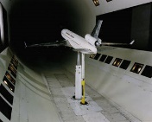
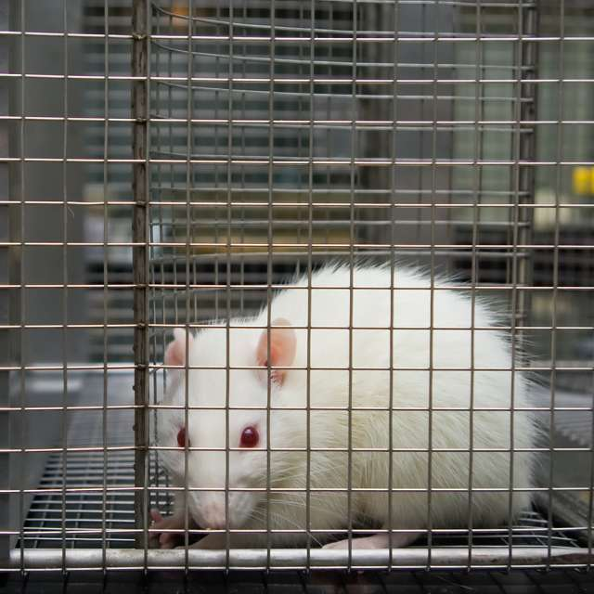
Types of Models
A model can be physical , such as a scale model of an airplane to study aerodynamic behavior.

Slide 9
Types of Models
A model can be notional i.e. a model consists of a set of mathematical equations or logic statements that describes the behavior of the system.
Mathematical model
Simple equations often result in analytic solutions that has mathematical proofs.
Some mathematical models require numerical solutions
Logical model
Software analysis/design models, computer programs

Slide 10
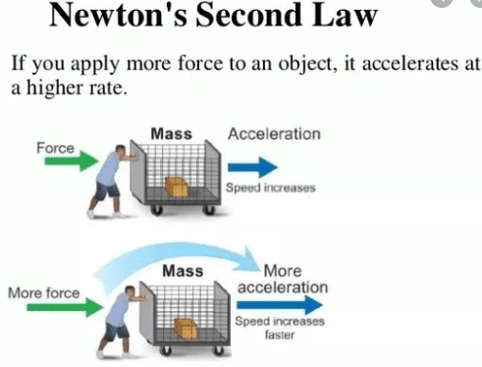
Example of Mathematical model
F = ma

Slide 11
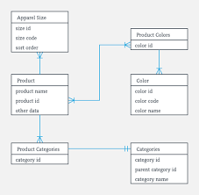
Example of a Logical model
An example Class Diagram

Slide 12
Modeling
Modeling
Application of Methods to Analyze Complex, Real-World Problems in order to make predictions about what might happen with various actions.
Modeling is needed to
Describe
Understand
Predict
Control a phenomenon

Slide 13
Modeling Process
Analyze the Problem
Formulate a Model
Gather Data
Make Simplifying assumptions (and gather data)
Determine variables
Establish relationships between variables
Determine Equations and Functions
Solve / Simulate
Verify / Interpret Model Solution

Slide 14
Types of Modeling
Physics-Based Modeling
Physics - based modeling is solidly grounded in mathematics.
A physics - based model is a mathematical model where the model equations are derived from basic physical principles.
Data - based modeling results from models based on data describing represented aspects of the subject of the model.
Model development begins with advanced research or data collection, which is used in simulations.
When the physics of the model subject is not understood or computations costs are high, data - based modelling can substitute.
This modeling relies on data availability — it functions at its best when the data are accurate and reliable.

Slide 15
Types of Modeling
Agent-Based Modeling (ABM)
ABMs consist of agents that are defined as autonomous software entities that interact with their environment or other agents to achieve some goal or accomplish some task .
An agent’s environment and the existence of other agents in that environment also play a key role on how an agent may behave.

Slide 16
Simulation
A nontechnical term meaning not real, imitation
A method for implementing a model over time
A technique for testing, analysis, or training in which real - world systems are used, or where real - world and conceptual systems are reproduced by a model
An unobtrusive scientific method of inquiry involving experiments with a model, rather than with the portion of reality that the model represents
A methodology for extracting information from a model by observing the behavior of the model as it is executed
Simulation is an applied methodology that can describe the behavior of that system using either a mathematical model or a symbolic model.
It can be the imitation of the operation of a real - world process or system over a period of time.

Slide 17
Types of Simulation
A live simulation involves real people operating real systems.
War games
The purpose of live simulation training is to provide a meaningful and useful experience for the trainee.

Slide 18
Types of Simulation
A virtual simulation is different from live simulation in that it involves real people operating in simulated systems.
These systems are recreated with simulators, and they are designed to immerse the user in a realistic environment.
cockpit simulator
Constructive simulation
This simulation involves real people making inputs into a simulation that carry out those inputs by simulated people operating in simulated systems.
The expected result of constructive simulation is that it will provide a useful result.

Slide 19
Paradigms of Simulation
Continuous simulation
The system variables are continuous functions of time .
Time is the independent variable and the system variables evolve as time progresses.
Continuous simulations systems make use of differential equations in developing the model
Monte Carlo simulation (also called the Monte Carlo method),
Randomly samples values from each input variable distribution and uses that sample to calculate the model ’ s output.
This process of random sampling is repeated until there is a sense of how the output varies given the random input values.
Monte Carlo simulation models system behavior using probabilities.

Slide 20
Paradigms of Simulation
Discrete - event simulation
The system variables are discrete functions in time .
These discrete functions in time result in system variables that change only at distinct instants of time.
The changes are associated with an occurence of a system event.
Discrete - event simulations advance time from one event to the next event.
This simulation paradigm adheres to queuing theory models.
Continuous and discrete-event simulations are dynamic systems with variables changing over time.

Slide 21
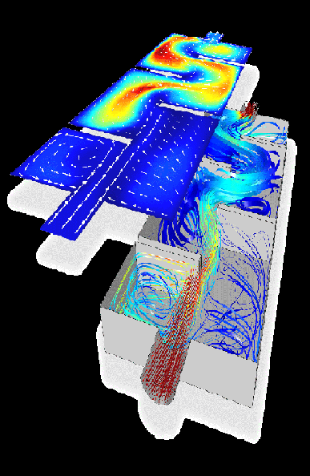
Lecture 1
Computer Modeling and Simulation
Applications of Modeling and Simulations (1)
Fig.1: Fluid Flow in a chamber (Computational Fluid Dynamics) IMG: http://comsol.com

Slide 22
Lecture 1
Computer Modeling and Simulation
Applications of Modeling and Simulations (2)
Fig. 2: Behaviour of Magnetic Field distribution inside constrained area (Computational Micromagnetism) IMG:Southampton University

Slide 23
Lecture 1
Computer Modeling and Simulation
Applications of Modeling and Simulations (3)
Fig. 3: Weather Forecasting (IMG: maxsea.com)

Slide 24
Lecture 1
Computer Modeling and Simulation
Applications of Modeling and Simulations (4)
Fig. 5: Boeing 737 Flight Simulator IMG: simjet.com.au

Slide 25
Lecture 1
Computer Modeling and Simulation
Applications of Modeling and Simulations (5)
Fig. 6: Examples of Network Simulations in Omnet++ (IMG: omnetplusplus.blogspot.com)

Slide 26
Lecture 1
Computer Modeling and Simulation
Applications of Modeling and Simulations (6)
Fig. 6: Simulation of Urban Mobility (SUMO)

Slide 27
Lecture 1
Computer Modeling and Simulation
Applications of Modeling and Simulations (7)
Fig. 7: Crowd Modelling during Tawaf IMG: L. Manenti et. al., MAKKSim: Dealing with
Pedestrian Groups in MAS-based Crowd Simulation

Slide 28
Course Overview
15% Sessional 1
15% Sessional 2
40% Final Term
10% Quizzes
20% Assignments

